Slide 1
Data warehouse 101
Powered by Techknow
August 2016

Slide 2











Journey of data in an organization
Customers
Applications
Data storage
at transactional level
Operational Reporting on OLTP
Data Governance
Data
Integration
Decision Support
Data/Decision Science
OLAP
Data Warehousing

Slide 3
OLTP vs OLAP
 | Online Transaction Processing | Online Analytical Processing
Source of Data | Operational data; OLTPs are the original source of the data | Consolidation data; OLAP data comes from the various OLTP Databases
Purpose of data | To control and run fundamental business tasks | To help with planning, problem solving and decision support
What the data | Reveals a snapshot of ongoing business processes | Multi-dimensional views of various kinds of business activities
Inserts and Updates | Short and fast inserts and updates initiated by end users | Periodic long-running batch jobs refresh the data
Queries | Relatively standardized and simple queries Returning relatively few records | Often complex queries involving aggregations
Processing speed | Typically very fast | Depends on the amount of data involved; query speed can be improved by creating indexes
Space Requirements | Can be relatively small if historical data is archived | Larger due to the existence of aggregation structures and history data; requires more indexes than OLTP
Database Design | Highly normalized with many tables | Typically de-normalized with fewer tables; use of star and/or snowflake schemas
Backup and Recovery | Backup religiously; operational data is critical to run the business, data loss is likely to entail significant monetary loss and legal liability | Instead of regular backups, some environments may consider simply reloading the OLTP data as a recovery method

Slide 4
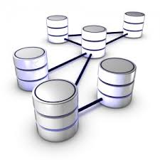
Normalization of Database
Database Normalization is a technique of organizing the data in the database
It is a systematic approach of decomposing tables to eliminate data redundancy, ensuring data dependencies make sense and undesirable characteristics like Insertion, Update and Delete anomalies
It is a multi-step process that puts data into tabular form by removing duplicated data from the relation tables
Without normalization, it becomes difficult to handle and update the database
Normalization rule are divided into;
First normal form
Second normal form
Third normal form
Fourth Normal Form

Slide 5
Insert, update and delete anomalies
Emp_id | Emp_name | Emp_address | Emp_dept
101 | Rick | Delhi | Market
101 | Rick | Delhi | Sales
201 | John | Pune | HR
301 | Ram | Chennai | Market
401 | Rai | Bangalore | Finance
401 | Rai | Bangalore | Sales
Insert
Update
Delete
Suppose a new employee joins the company, who is under training and currently not assigned to any department
We would not be able to insert the data into the table if emp_dept field doesn’t allow nulls
If the above table, two rows are presented for employee Rick
If we want to update the address for Rick, we have to update two rows
Else data will be inconsistent and Rick will have two different addresses
Suppose if department Sales closes and we have to delete the department entry
What will happen to employee information, how are working in that department

Slide 6
First Normal Form (1NF)
Each cell to be single valued
Entries in columns are same type
Rows uniquely identified – Add unique ID or Add more columns to make unique
Cust Name | Item | Address | Newsletter | Supplier | Supplier phone | Price
Alan Smith | Xbox One | Boston | Xbox News | Microsoft | 123-321-0001 | 250
Roger Jr | PlayStation 4 | New Jersey | PlayStation News | Sony | 321-432-1234 | 300
Doug | Xbox One, PS vita | Denver | Xbox News PlayStation News | Wholesale | Toll-free | 550
Alan Smith | PlayStation 4 | Boston | PlayStation News | Sony | 321-432-1234 | 300
Primary Key
Cust_ID | Cust Name | Item | Address | Newsletter | Supplier | Supplier phone | Price
101 | Alan Smith | Xbox One | Boston | Xbox News | Microsoft | 123-321-0001 | 250
102 | Roger Jr | PlayStation 4 | New Jersey | PlayStation News | Sony | 321-432-1234 | 300
103 | Doug | Xbox One | Denver | Xbox News | Microsoft | 000-111-1234 | 250
104 | Alan Smith | PlayStation 4 | Boston | PlayStation News | Sony | 874-432-1234 | 300
103 | Doug | PlayStation | Denver | PlayStation News | Sony | 000-111-1234 | 300

Slide 7
Second Normal Form (2NF)
It is in 1NF and no partial dependency exists between non-key attributes and key attributes
Cust_ID | Cust Name | Item | Address | Newsletter | Supplier | Supplier phone | Price
101 | Alan Smith | Xbox One | Boston | Xbox News | Microsoft | 123-321-0001 | 250
102 | Roger Jr | PlayStation 4 | New Jersey | PlayStation News | Sony | 321-432-1234 | 300
103 | Doug | Xbox One | Denver | Xbox News | Microsoft | 123-321-0001 | 250
104 | Alan Smith | PlayStation 4 | Boston | PlayStation News | Sony | 321-432-1234 | 300
103 | Doug | PlayStation | Denver | PlayStation News | Sony | 321-432-1234 | 300
Cust_ID | Cust Name | Address | Newsletter
101 | Alan Smith | Boston | Xbox News
102 | Roger Jr | New Jersey | PlayStation News
103 | Doug | Denver | Xbox News
104 | Alan Smith | Boston | PlayStation News
103 | Doug | Denver | PlayStation News
Item | Supplier | Supplier phone | Price
Xbox One | Microsoft | 123-321-0001 | 250
PlayStation 4 | Sony | 321-432-1234 | 300
PlayStation | Sony | 321-432-1234 | 300
Cust_ID | Item

Slide 8
Third Normal Form (3NF)
It is in 2NF and All columns can be determined only by the key in the table and no other columns
Cust_ID | Cust Name | Address | Newsletter
101 | Alan Smith | Boston | Xbox News
102 | Roger Jr | New Jersey | PlayStation News
103 | Doug | Denver | Xbox News
104 | Alan Smith | Boston | PlayStation News
103 | Doug | Denver | PlayStation News
Item | Supplier | Supplier phone | Price
Xbox One | Microsoft | 123-321-0001 | 250
PlayStation 4 | Sony | 321-432-1234 | 300
PlayStation | Sony | 321-432-1234 | 300
Cust_ID | Item

Slide 9
Cont.
Cust_ID | Cust Name | Address | Newsletter
101 | Alan Smith | Boston | Xbox News
102 | Roger Jr | New Jersey | PlayStation News
103 | Doug | Denver | Xbox News
104 | Alan Smith | Boston | PlayStation News
103 | Doug | Denver | PlayStation News
Item | Supplier | Price
Xbox One | Microsoft | 250
PlayStation 4 | Sony | 300
PlayStation | Sony | 300
Cust_ID | Item
Supplier | Supplier phone
Microsoft | 123-321-0001
Sony | 321-432-1234

Slide 10
Fourth Normal Form (4NF)
It is in 3NF and no multiple value dependencies
Cust_ID | Cust Name | Address | Newsletter
101 | Alan Smith | Boston | Xbox News
102 | Roger Jr | New Jersey | PlayStation News
103 | Doug | Denver | Xbox News
104 | Alan Smith | Boston | PlayStation News
103 | Doug | Denver | PlayStation News
Item | Supplier | Price
Xbox One | Microsoft | 250
PlayStation 4 | Sony | 300
PlayStation | Sony | 300
Cust_ID | Item
Supplier | Supplier phone
Microsoft | 123-321-0001
Sony | 321-432-1234

Slide 11
Cont.
Cust_ID | Cust Name | Address
101 | Alan Smith | Boston
102 | Roger Jr | New Jersey
103 | Doug | Denver
104 | Alan Smith | Boston
Item | Supplier | Price
Xbox One | Microsoft | 250
PlayStation 4 | Sony | 300
PlayStation | Sony | 300
Cust_ID | Item
101 | Xbox One
102 | PlayStation 4
103 | Xbox One
104 | PlayStation 4
103 | Play Station
Cust_ID | Newsletter
101 | Xbox News
102 | PlayStation News
103 | Xbox News
104 | PlayStation News
103 | PlayStation News
Supplier | Supplier phone
Microsoft | 123-321-0001
Sony | 321-432-1234

Slide 12
What is Business Intelligence?
Business intelligence (BI) can be described as "a set of techniques and tools for the acquisition and transformation of raw data into meaningful and useful information for business analysis purposes“
In the BI environment we can found these types of product:
OLAP (PowerPlay)
Reporting (Impromptu)
Scorecarding (KPI)
Dashboards (Visualizer)
ETL (Decision stream)
DW (Data warehouse, your favorite RDBMS)
And other products like alerters, schedulers, datamining, ……
Easy to access &
share information
Helps to know
your business
Enables real-time
analytics with Quick
navigation
How Business
Intelligence helps?
Reduce the risk
of bottlenecks
Improve decision
making process
Helps identify
waste in your system

Slide 13
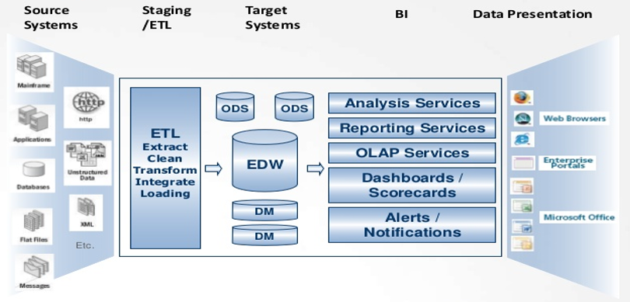
DWBI Architecture

Slide 14
What is Data Warehouse and DataMart
Data warehouse
A data warehouse is a relational database that is designed for query and analysis rather than for transaction processing
It usually contains historical data derived from transaction data, but it can include data from other sources.
It separates analysis workload from transaction workload and enables an organization to consolidate data from several sources
Characteristics of Data warehouse:
Subject Oriented
Non-volatile
Time variant
Data mart
A data mart is subset of data warehouse and it supports a particular region, business unit or business function
Types of Data marts:
Dependent data mart (Top-down/Bill Inmon’s approach) – Data first extracted from OLTP systems into DWH and then travels down to the data mart
Independent data mart (Bottom-up/Ralph Kimball’s approach) – Data extracted from OLTP systems directly to the data marts
Hybrid data mart – Data is fed both OLTP systems as well as Data warehouse
ODS
An operational data store (or "ODS") is a database designed to integrate data from multiple sources for additional operations on the data. Unlike a master data store the data is not passed back to operational systems. It may be passed for further operations and to the data warehouse for reporting

Slide 15
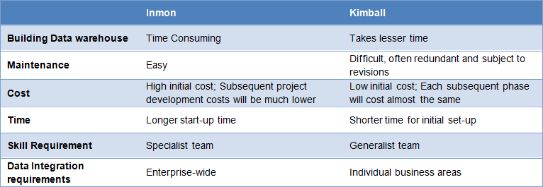
Difference between Data mart vs Data warehouse and Inmon’s vs Kimball’s approaches
Data warehouses | Data Marts
Enterprise wide data | Department wide data
Multiple subject areas | Single subject area
Multiple data sources | Limited data sources
Occupies large memory | Occupies limited memory
Longer time to implement | Shorter time to implement

Slide 16
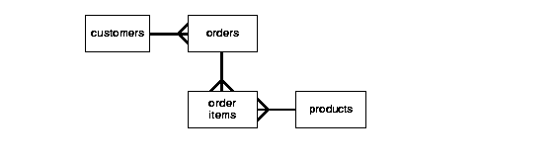
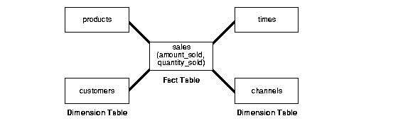
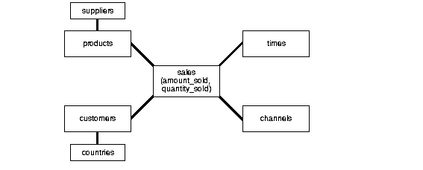
Data Modelling Techniques
- Third Normal Form
- Star schema
- Snowflake schema

Slide 17
Types of Dimensions
Types of Dimensions
Conformed Dimension
Junk Dimension
Role playing Dimension
Degenerated Dimension
Slow Changing Dimension

Slide 18
Slowing Changing Dimension (SCD)
Dimension attributes(columns) that change slowly over a period of time rather than changing regularly
Example: A person changing his/her city
There are 3 types in which these types of attributes are handled
SCD
Type 1
Overwrite the old value
Type 2
Add a new row
Type 3
Add a new column

Slide 19
SCT Type 1 – Overwrite the old value
Before Change
ID | Year | Name | City
1 | 2012 | James | Bangalore
After Change
ID | Year | Name | City
1 | 2015 | James | Pune
The advantage of this approach is that it is very easy to follow and results in huge space saving
The disadvantage is that no history is maintained

Slide 20
SCT Type 2 – Add a new row
Before Change
ID | Year | Name | City
1 | 2012 | James | Bangalore
After Change
ID | Year | Name | City
1 | 2012 | James | Bangalore
2 | 2016 | James | Pune
New row is added
The advantage of this approach is that complete history is maintained
The disadvantage is that it results in huge space allocation

Slide 21
SCT Type 2 – Add a new row (Challenges)
It is relatively difficult to determine which record is the most recent
To overcome this, there are 2 approaches to indicate the most recent record
Approach 1 – Use start and end dates
ID | Start_date | End_date | Name | City
1 | 2012-01-01 | 2016-01-31 | James | Bangalore
2 | 2016-02-01 | 9999-12-31 | James | Pune
Approach 2 - Use an indicator
ID | Year | Name | City | Flag/Indicator
1 | 2012 | James | Bangalore | N
2 | 2016 | James | Pune | Y

Slide 22
SCD Type 3 – Add a new column
Some times it is not required to maintain the entire history
We might want to retain the current record and the immediate previous record
In such cases instead of adding rows, it is beneficial to add columns as below
ID | Year | Name | City | Old city | Old year
1 | 2016 | James | Pune | Bangalore | 2012
The disadvantage of the above approach is, for each attribute there must be 2 columns

Slide 23
Conformed Dimension
Conformed dimension means the exact same thing every possible fact table to which they are joined
Example: A date dimension table connected to the sales fact as well as inventory and so on
Date Dimension
Sales Fact
Inventory Fact
Claim Fact

Slide 24
Degenerate Dimension
A dimension which is stored in a fact table and has no association with any dimension table
Example:
Invoice_nbr | Product_id | Quantity | Amount
1112223 | 10001 | 2 | 200
1225544 | 10002 | 3 | 300
1234533 | 10003 | 1 | 100
Above table is a fact table that has quantity and amount as measures
Product_id comes from Product dimension table. Invoice number is a standalone number. It has no other attributes associated with it
But sometimes if we would want to know the quantity of products and amount spent per invoice, we need to add invoice to fact table

Slide 25
Junk Dimension
Consider web page visits, there are multiple flags that are set when a transaction tales place like single page visits and multiple page visits
Date_id | OS_id | Browser_id | Visit_cnt | Clicks_cnt | Page_flag | Support_flag
43201 | 980796 | 763542 | 200 | 500 | 0 | 0
43201 | 980796 | 763542 | 400 | 600 | 1 | 0
43201 | 980796 | 763542 | 300 | 450 | 0 | 1
43201 | 980796 | 763542 | 100 | 210 | 1 | 1
Accommodating them in a fact table will make the no of fields in a fact table huge and results in performance
These flags don’t integrate with the common dimension like Date, OS, Browser, etc.
Junk Dimension
ID | Page_flag | Support_flag
1 | 0 | 0
2 | 1 | 0
3 | 0 | 1
4 | 1 | 1
After change
Date_id | OS_id | Browser_id | Visit_cnt | Clicks_cnt | Junk_id
43201 | 980796 | 763542 | 200 | 500 | 1
43201 | 980796 | 763542 | 400 | 600 | 2
43201 | 980796 | 763542 | 300 | 450 | 3
43201 | 980796 | 763542 | 100 | 210 | 4

Slide 26
Role Playing Dimension
A dimension table that has multiple valid relationships with a fact table
Example: Date dimension can be used to fetch order placed date, order shipment date, order closure date
As can be seen below, there are multiple keys in the fact table pointing to the same dimension
Date Dimension
Order placed key
Shipment date
Closure data
Date key
Hence we need not create three dimensions tables to link to the three columns in the fact table
It saves time and memory space

Slide 27


Types of Facts
Additive
Non-Additive
No of products sold on Day 1 = 500
No of products sold on Day 2 = 350
-----------------------------------------------------------
Total no of products sold = 850
Profit margin on Day 1 = 50%
Profit margin on Day 2 = 35%
-----------------------------------------------------------------
Total profit margin for two days = 85%
Balance of Account A on Day 1 = 5000
Balance of Account B on Day 1 = 3000
-------------------------------
Tot balance in two acct on Day 1 = 8000
Balance of Account A on Day 1 = 2000
Balance of Account A on Day 2 = 5000
-------------------------------
Tot balance in acct A in two Days = 7000
Only dimension ID's are present, no measurable attribute i.e. No fact
Semi-Additive
Factless fact

Slide 28
Most large technology firms have their ETL tools on the market with a small smattering of open source tools
ETL Tools List
ETL Tool Name | ETL Vendor | ETL Tool Name | ETL Vendor
Ab Initio | Ab Initio Corporation | Oracle Data Integrator (ODI) | Oracle
Power Center Informatica | Informatica | Data Manager/Decision Stream | IBM (Cognos)
Data Stage | IBM | Clover ETL | Javlin*
SSIS | Microsoft | Data Services | SAP Business Objects
Oracle Warehouse Builder | Oracle | Centerprise | Astera
SAS Data Integration Studio | SAS Institute | DB2 Infosphere Warehouse Edition | IBM
Elixir Repertoire | Elixir | Pentaho Data Integration | Pentaho*
Data Migrator | Information Builders | Adeptia Integration Suite | Adeptia
Talend Studio for Data Integration | Talend* | DMExpress | Syncsort
Dataflow Manager | Pitney Bowes Business Insight | Expressor Data Integration | QlikTech
Pervasive Data Integrator | Pervasive Software
Open text Integration Center | Open Text
* open source ETL tool

Slide 29
Most large technology firms have their BI tools on the market with a small smattering of open source tools
BI Tool name | Vendor | BI Tool name | Vendor
Cognos | IBM | Jasper* | Jasper Soft
Business Objects | SAP | Oracle Enterprise BI Server | Oracle
Hyperion | Oracle | Webfocus | Information Builder
Microstrategy | Microstrategy | Microsoft BI Tools | Microsoft
SAS Enterprise BI server | SAS | SAP NetWeaver BI | SAP
QlikView | Qlik Tech | Style intelligence | InetSoft
Spotfire | Tibco
Tableau | Tableau
Pentaho BI* | Pentaho

Slide 30
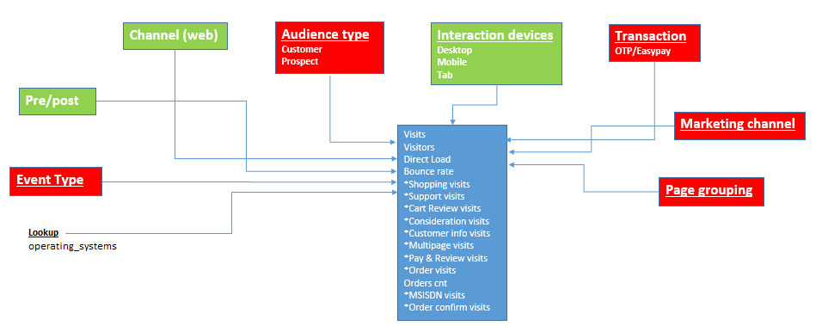
SiteCat Entity Relationship(ER) Diagram

Slide 31
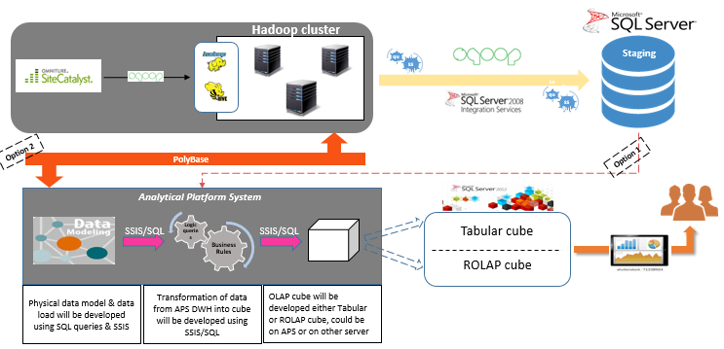
SiteCat System Architecture

Slide 32
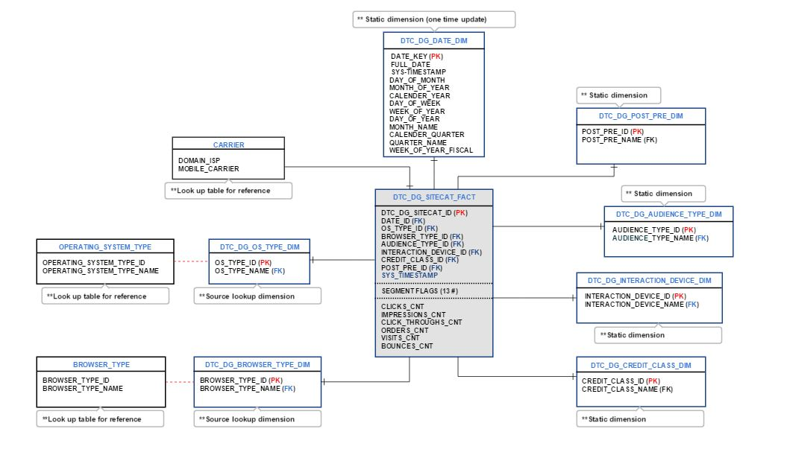
Logical Data Model

Slide 33
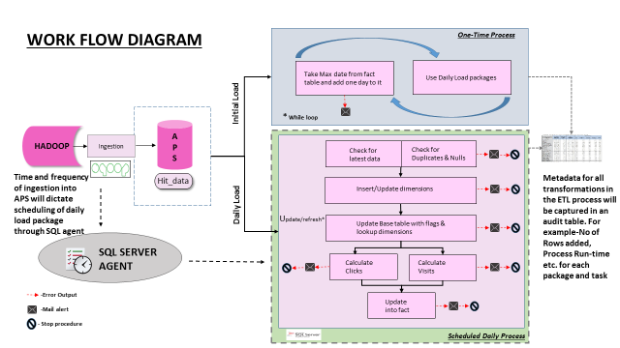
SiteCat ETL work flow diagram

Slide 34
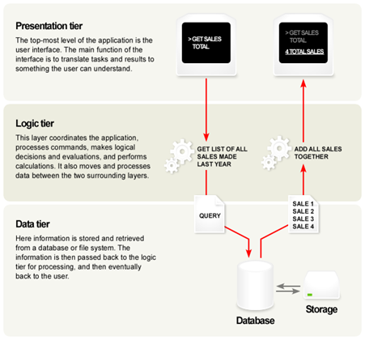
Common Enterprise client & server Architecture
Advantages
Managing data is independent from the physical storage
Migration to new graphical environments is faster
It is possible to make changes on the presentation level without affecting the other two (business or data access layer)
As each tier is independent it is possible to use different sets of developers
Since the client doesn’t have direct access to the database business logic is more secure
When one tier fails there is no data loss, because you are always secure by accessing the other tier.
Disadvantages
It is more complex structure
More difficult to set up and maintain it as well
The physical separation of the tiers may affect the performance between the three
It is more difficult to built a 3-tier application

Slide 35









Database vendors using 3-tier Architecture

Slide 36
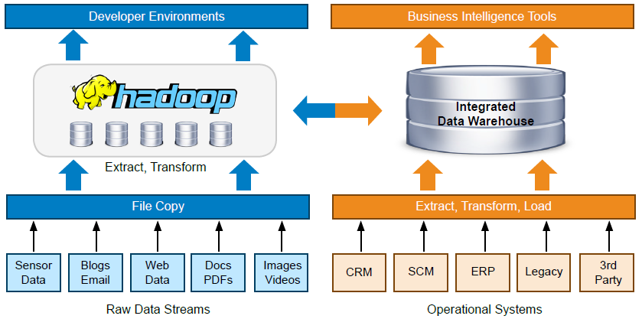
Hadoop and MapReduce solutions are being deployed in enterprises together with data warehouses

Slide 37
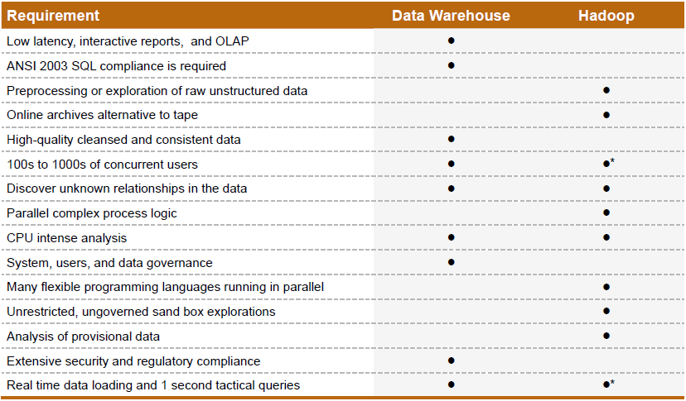
Hadoop and DWH: When to use which

